Slide 1
CSE225: Data Structure And Algorithms
Lecture-09: Link List

Slide 2
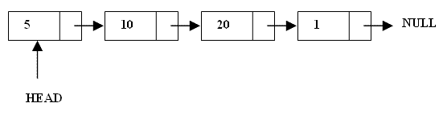
What are Linked Lists
A linked list is a linear data structure.
Nodes make up linked lists.
Nodes are structures made up of data and a pointer to another node.
Usually the pointer is called next.

Slide 3
Arrays Vs Linked Lists
Arrays | Linked list
Fixed size: Resizing is expensive | Dynamic size
Insertions and Deletions are inefficient: Elements are usually shifted | Insertions and Deletions are efficient: No shifting
Random access i.e., efficient indexing | No random access → Not suitable for operations requiring accessing elements by index such as sorting
No memory waste if the array is full or almost full; otherwise may result in much memory waste. | Since memory is allocated dynamically (according to our need) there is no waste of memory.
Sequential access is faster [Reason: Elements in contiguous memory locations] | Sequential access is slow [Reason: Elements not in contiguous memory locations]

Slide 4
Types of lists
There are two basic types of linked list
Singly Linked list
Doubly linked list

Slide 5
Singly Linked List
Each node has only one link part
Each link part contains the address of the next node in
the list
Link part of the last node contains NULL value which
signifies the end of the node

Slide 6
Schematic representation
Here is a singly-linked list (SLL):
myList
a
b
c
d
Each node contains a value(data) and a pointer to the next node in the list
myList is the header pointer which points at the first node in the list

Slide 7
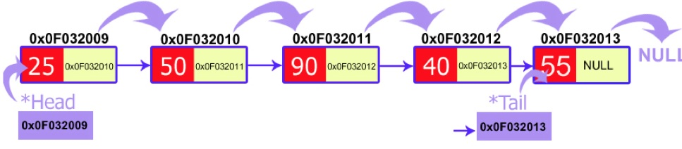

Slide 8
Basic Operations on a list
Creating a List
Inserting an element in a list
Deleting an element from a list
Searching a list
Reversing a list

Slide 9
Creating a node
struct node{
int data; node*next;
};
// A simple node of a linked list
//start points at the first node
initialised to NULL at beginning
class Node
{
public:
int data;
Node *next;
};

Slide 10
Insertion Description
Insertion at the beginning of the list
Insertion at the end of the list
Insertion in the middle of the list

Slide 11
Insertion at the beginning
Steps:
Create a Node
Set the node data Values
Connect the pointers

Slide 12


Insertion Description
head
48
17
142
//
Follow the previous steps and we get
Step 1
Step 2
Step 3
head
93

Slide 13
Insertion at the end
Steps:
Create a Node
Set the node data Values
Connect the pointers

Slide 14



Insertion Description
head
48
17
142
//
Follow the previous steps and we get
Step 1
Step 2
Step 3

Slide 15
Insertion in the middle
Steps:
Create a Node
Set the node data Values
Break pointer connection
Re-connect the pointers

Slide 16




Insertion Description
Step 1
Step 2
Step 3
Step 4

Slide 17
switch(ch)
{
case 1:
temp->next=first;
first=temp; break;
case 2:
last->next=temp;
last=temp; break;
case 3:
cout<<"\nEnter the Position to Insert:";
cin>>pos;
while(count!=pos)
{
prev=cur;
cur=cur->next;
count++;
}
if(count==pos)
{
prev->next=temp;
temp->next=cur;
}
else
cout<<"\nNot Able to Insert";
break;
}
}

Slide 18
Deletion Description
Deleting from the beginning of the list
Deleting from the end of the list
Deleting from the middle of the list

Slide 19
Deleting from the beginning
Steps
Break the pointer connection and assign to temp node
Re-connect the nodes change the starting node to next
Delete the node
void delete_first()
{
node *temp=new node;
temp=head;
head=head->next;
delete temp;
}

Slide 20
Deletion Description
head
6
4
17
42
head
6
4
17
42
head
4
17
42

Slide 21
Deleting from the end
Steps
Break the pointer connection
Set previous node pointer to NULL
Delete the node

Slide 22
Deletion Description
head
6
4
17
42
head
6
4
17
42
head
6
4
17

Slide 23
Deleting from the Middle
Steps
Set previous Node pointer to next node
Break Node pointer connection
Delete the node

Slide 24
Deletion Description
head
4
17
42
head
4
17
42
head
4
42

Slide 25
Display the list
void display()
{
node *temp=new node;
temp=head;
while(temp!=NULL)
{
cout<<temp->data<<"\t";
temp=temp->next;
}
}

Slide 26
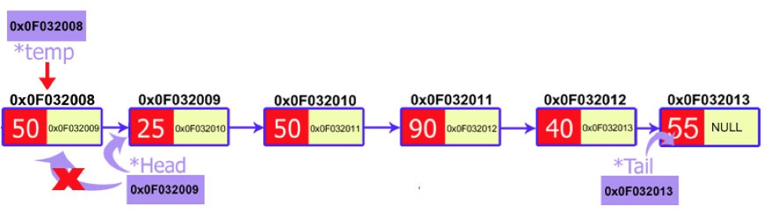
Delete First Node
void delete_first()
{
node *temp=new node;
temp=head;
head=head->next;
delete temp;
}

Slide 27
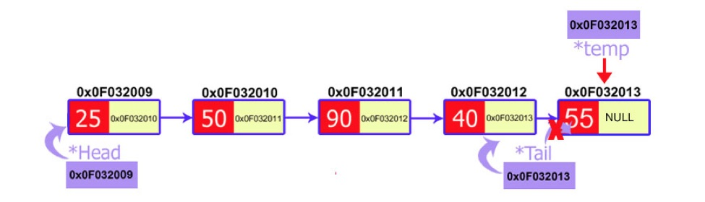
Delete Last Node
void delete_last()
{
node *current=new node;
node *previous=new node; current=head;
while(current->next!=NULL)
{
previous=current;
current=current->next;
}
}
tail=previous;
Previous->next=NULL; delete current;
}

Slide 28
Deleting a particular node
Here we make the next pointer of the node previous to the node being deleted ,point to the successor node of the node to be deleted and then delete the node using delete keyword
node1 node2 node3 To be deleted

Slide 29
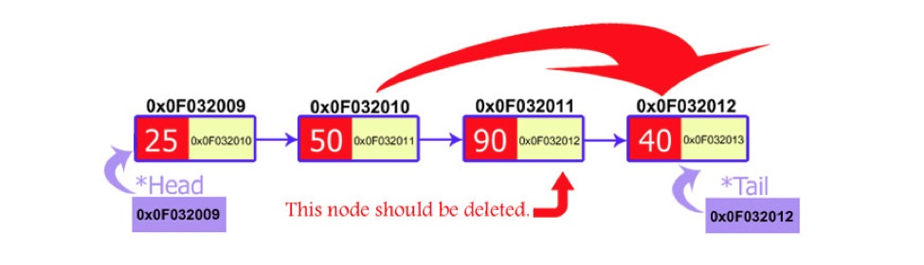
void delete_position(int pos)
{
node *current=new node;
node *previous=new node; current=head;
for(int i=1;i<pos;i++)
{
previous=current; current=current->next;
}
previous->next=current->next; }

Slide 30
Searching a SLL
Searching involves finding the required element in the list
We can use various techniques of searching like linear search or binary search where binary search is more efficient in case of Arrays
But in case of linked list since random access is not available it would become complex to do binary search in it
We can perform simple linear search traversal

Slide 31
In linear search each node is traversed till the data in
void search(int x)
{
node*temp=start; while(temp!=NULL)
{
if(temp->data==x)
{
cout<<“Found the item”<<x;
break;
}
temp=temp->next;
}
}

Slide 32
COMPLEXITY OF VARIOUS OPERATIONS
IN ARRAYS AND SLL
Operation | ID-Array Complexity | Singly-linked list Complexity
Insert at beginning | O(n) | O(1)
Insert at end | O(1) | O(1) if the list has tail reference O(n) if the list has no tail reference
Insert at middle | O(n) | O(n)
Delete at beginning | O(n) | O(1)
Delete at end | O(1) | O(n)
Delete at middle | O(n): O(1) access followed by O(n) shift | O(n): O(n) search, followed by O(1) delete
Search | O(n) linear search O(log n) Binary search | O(n)
Indexing: What is the element at a given position k? | O(1) | O(n)

Slide 33
Insertion at the beginning of the Singly linked lists
Step 1. Create a new node and assign the address to any node
say ptr.
Step 2. OVERFLOW,IF(PTR = NULL)
write : OVERFLOW and EXIT.
Step 3. ASSIGN INFO[PTR] = ITEM
Step 4. IF(START = NULL)
ASSIGN NEXT[PTR] = NULL
ELSE
ASSIGN NEXT[PTR] = START
Step 5. ASSIGN START = PTR
Step 6. EXIT

Slide 34
Search an element in a Linked List
Iterative Solution
Recursive Solution
bool search(Node *head, int x)
1) Initialize a node pointer, current = head.
2) Do following while current is not NULL
a) current->key is equal to the key being searched
return true.
b) current = current->next
2) Return false
bool search(head, x)
1) If head is NULL, return
false.
2) If head's key is same as x,
return true;
Else return
search(head->next, x)

Slide 35
Algorithm for Deletion at beginning of the list
DELETE AT BEG(INFO,NEXT,START)
1.IF(START=NULL)
2.ASSIGN PTR = STRAT
3.ASSIGN TEMP = INFO[PTR]
4.ASSIGN START = NEXT[PTR]
5.FREE(PTR)
6.RETURN(TEMP)

Slide 36
Doubly Linked List
1. Doubly linked list is a linked data structure that consists of a set of sequentially linked records called nodes.
2 .
Each node contains three fields ::
one is data part which contain data only.
two other field is links part that are point or references to the previous or to the next node in the sequence of nodes.
3.
The beginning and ending nodes' previous and next links, respectively, point to some kind of terminator, typically a sentinel node or null to facilitate traversal of the list.

Slide 37
NODE
previous | data | next
A
B
C
NULL
11
786
200 | 656 | 400
786
777
NULL
200
786
400
A doubly linked list contain three fields: an integer value, the
link to the next node, and the link to the previous node.

Slide 38
DLL’s compared to SLL’s
Advantages:
Can be traversed in either direction (may be essential for some programs)
Some operations, such as deletion and inserting before a node, become easier
Disadvantages:
Requires more space
List manipulations are slower (because more links must be changed)
Greater chance of having bugs (because more links must be manipulated)

Slide 39
Structure of DLL
struct node
{
int data; node*next; node*previous;
};
//holds the address of previous node
previous.
.Data
.next
inf

Slide 40


Inserting at beginning

Slide 41
void insert_beg(node *p)
{
if(start==NULL)
{
start=p;
cout<<"\nNode inserted successfully at the beginning\m";
}
else
{
node* temp=start;
start=p;
temp->previous=p; new node
p->next=temp;
1st node
//making 1st nodes previous point to the
//making next of the new node point to the
cout<<"\nNode inserted successfully at the beginning\n";
}

Slide 42
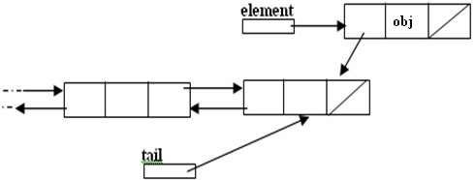
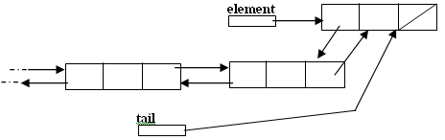
Inserting at the end

Slide 43
void insert_end(node* p)
{
if(start==NULL)
{
start=p;
cout<<"\nNode inserted successfully at the end";
}
else
{
node* temp=start; while(temp->next!=NULL)
{
temp=temp->next;
}
temp->next=p;
p->previous=temp;
cout<<"\nNode inserted successfully at the end\n";
}
}

Slide 44
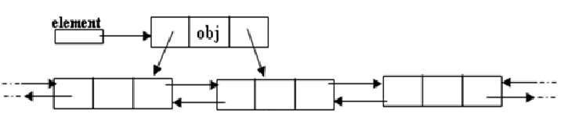
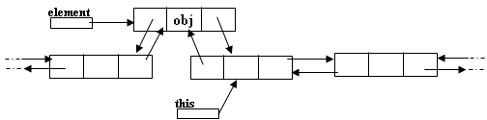
Inserting after a node
Making next and previous pointer of the node to be inserted point accordingly
Adjusting the next and previous pointers of the nodes b/w which the new node accordingly

Slide 45
void insert_after(int c,node* p)
{
temp=start;
for(int i=1;i<c-1;i++)
{
temp=temp->next;
}
p->next=temp->next; temp->next->previous=p; temp->next=p;
p->previous=temp; cout<<"\nInserted successfully";
}

Slide 46
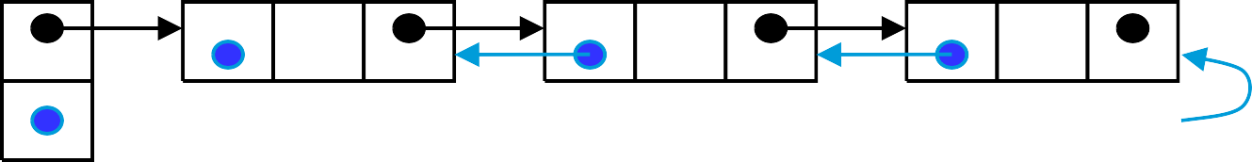
Deleting a node
Node deletion from a DLL involves changing two links
In this example,we will delete node b
myDLL
a b
c
We don’t have to do anything about the links in node b
Garbage collection will take care of deleted nodes
Deletion of the first node or the last node is a special case

Slide 47
void del_at(int c)
{
node*s=start;
{
for(int i=1;i<c-1;i++)
{
s=s->next;
}
node* p=s->next;
s->next=p->next;
p->next->previous=s; delete p;
cout<<"\nNode number "<<c<<" deleted successfully";
}
}
}

Slide 48
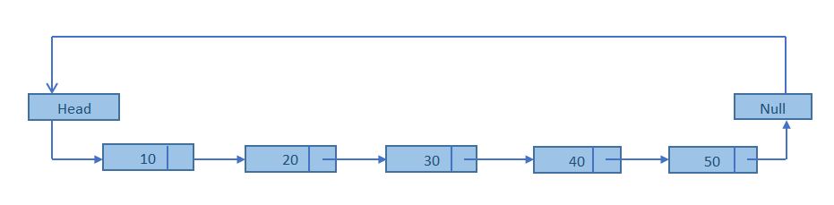
Circular Linked List
A circular linked list is a linked list in which the head element's previous pointer points to the tail element and the tail element's next pointer points to the head element.
2. A circularly linked list node looks exactly the same as a linear singly linked list.

Slide 49
Header Linked Lists
A Header Linked List always Contains a Special Node called Header Node
It has Two Types:
a) Grounded Header List
Last Node Contains the NULL Pointer
b) Circular Header List
Last Node Points Back to the Header Node

Slide 50
Graphical Representations
4
8
10
Start
Header
Node
Data
Link
Grounded Header Link List
LINK [START] = NULL
4
8
10
Start
Header
Node
Data
Link
Circular Header Link List
LINK [START] = START

Slide 51
APPLICATIONS OF LINKED LIST
Applications that have an MRU list (a linked list of file names)
The cache in your browser that allows you to hit the BACK button (a linked list of URLs)
Undo functionality in Photoshop or Word (a linked list of state)
A stack, hash table, and binary tree can be implemented using a doubly linked list.

Slide 52
Advantages of using an Array:
only good for non-sparse polynomials.
ease of storage and retrieval.
Disadvantages of using an Array:
have to allocate array size ahead of time.
huge array size required for sparse polynomials.
Waste of space and runtime.

Slide 53
Arrays and Linked Lists
Reading Assignments
• An array is a list store in contiguous memory.
– Any element of an array can be accessed quickly.
– Insertion and deletion in the middle of an array requires the movement of many elements.
– The size of an array is fixed.
• A linked list is a list scattered throughout memory and connected with pointers/Links of next element.
– The elements of a linked list must be accessed in order. Linear Access Mechanism
– Insertion and deletion only requires re-assignment of a few pointers.
– The length of the list can change at any time, making it a dynamic data structure.

Slide 54
Traversing a Linked List
1
4
8
10
Start
Data
Link
PTR:= LINK [PTR]
PTR
1. Set PTR := START
2. Repeat Steps 3-4 while PTR ≠ NULL
3. Apply process to INFO[PTR]
4. Set PTR:= LINK[PTR]
[end of loop]
5. Exit

Slide 55
Searching in a Linked List
LIST => Link List, LOC => ITEM Location or LOC => NULL
Search (LINK, START, ITEM, LOC)
Set PTR := START, LOC:= NULL
Repeat Steps 3-4 while PTR ≠ NULL
If INFO[PTR] = ITEM
Set LOC:=PTR
[end of If Structure]
Set PTR:= LINK[PTR]
[end of loop]
Return LOC

Slide 56
Insertion in a Linked List
1. Create a new Node and store data in that node.
2. Find the correct position in the list.
Assign the pointers to include the new node.
Algorithm: InsertFirst(START, ITEM)
Set New:= Create Node()
Set INFO [New] := ITEM and LINK [New] := NULL
Set START := New
Exit

Slide 57
Insertion In Sorted Linked List
Steps:
Find the Location of the node
Use Insertion method to insert into the Linked List
Find the Location of the node:
Search the Item after which insertion needs to be made.
As the Linked List is sorted searching will result in the location of element => Given ITEM
As Insertion can not be made before a Node therefore another pointer will keep track of the previous node i.e. before moving the PTR , Save := PTR
PTR points to current node Element which is => ITEM while SAVE points to Element before PTR.
Insertion will be made after SAVE

Slide 58
Algorithm: FindLoc (START,ITEM,LOC)
“Find Location in a Sorted Linked List”
If START = NULL, then
Set LOC := NULL and Return
Else if ITEM < INFO [START] [ITEM is not in List]
Set LOC := NULL and Return
[ End of if ]
Set SAVE := START and PTR := LINK [ START ]
Repeat Steps 3 - 4 while PTR ≠ NULL
If ITEM < INFO [ PTR ] then
Set LOC := SAVE and Return
Else
Set SAVE := PTR and PTR := LINK [ PTR ]
[ End of if ]
[ End of Step 4 loop ]
Set LOC := PTR and Return

Slide 59
Header Linked Lists
A Header Linked List always Contains a Special Node called Header Node
It has Two Types:
a) Grounded Header List
Last Node Contains the NULL Pointer
b) Circular Header List
Last Node Points Back to the Header Node

Slide 60
Graphical Representations
4
8
10
Start
Header
Node
Data
Link
Grounded Header Link List
LINK [START] = NULL
4
8
10
Start
Header
Node
Data
Link
Circular Header Link List
LINK [START] = START

Slide 61
Header Linked Lists
One way to simplify insertion and deletion is never to insert an item before the first or after the last item and never to delete the first node
You can set a header node at the beginning of the list containing a value smaller than the smallest value in the data set
You can set a trailer node at the end of the list containing a value larger than the largest value in the data set.
These two nodes, header and trailer, serve merely to simplify the insertion and deletion algorithms and are not part of the actual list.
The actual list is between these two nodes.

Slide 62
Doubly Linked Lists
A Doubly Linked List is List in which every Node has a Next Pointer and a Back Pointer
Every Node (Except the Last Node) Contains the Address of the Next Node, and Every Node (Except the First Node) Contains the Address of the Previous Node.
A Doubly Linked List can be Traversed in Either Direction

Slide 63
Definition and Graphical Representations
The Node is Divided into 3 parts
1) Information Field
2) Forward Link which Points to the Next Node
3) Backward Link which Points to the Previous Node
The starting Address or the Address of First Node is Stored in START / FIRST Pointer
Another Pointer can be used to traverse Doubly LL from End. This Pointer is Called END or LAST
4
X
2
10
Start
Last
INFO Field
FORE Pointer
BACK Pointer

